Slide 1
Final Presentation
Rebecca D’Agostino

Slide 2
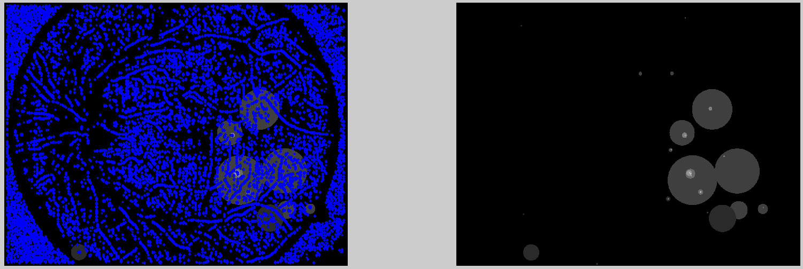
Current Results
Fixed using the mask and removing values off from the out of bounds.
Used matlab to cut and plot data into .csv files to train it later, using 100 negative patches with a 25% confidence for the positive patches.
Whiting was also used in order to try to increase the accuracy, which did not work.
Figure 1. Results without whiting, provided by Dr.Shan. The results with whiting have similar results.

Slide 3
Current Results
Raw data: {'accuracy': 0.02690171, 'auc': 0.0, 'false_negatives': 43443.0, 'false_postives': 0.0, 'loss': 19.650898, 'true_negatives': 0.0, 'true_postivies': 1201.0, 'global_step': 303000}
Not really working – some reasons?
Could be related to using little data
Can’t improve this since data is expensive to get
Also related to model or other reasons– seen in literature review

Slide 4
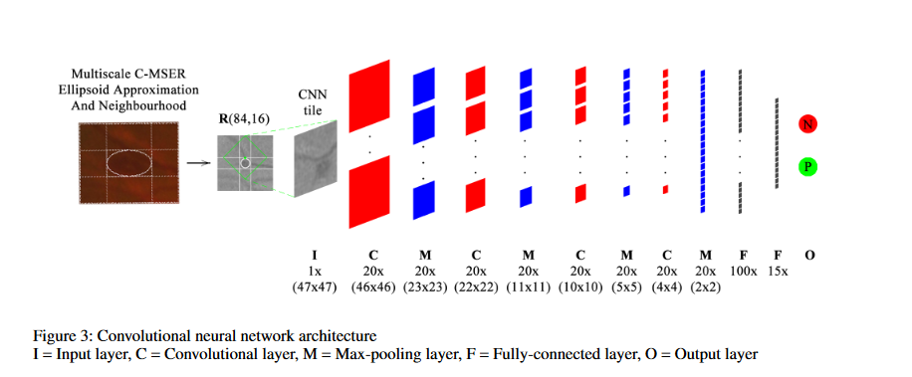
Literature Review
Transformed Representations for Convolutional Neural Networks in Diabetic Retinopathy Screening by Gilbert Lim, Mong Li Lee, Wynne Hsu and Tien Yin Wong, from Singapore

Slide 5
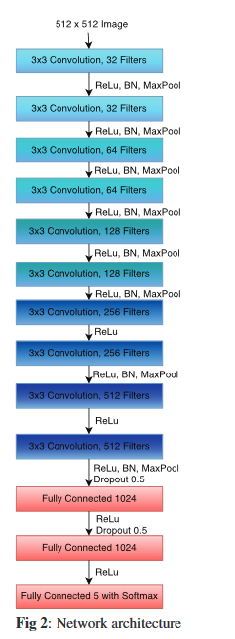
Second Paper
Convolutional Neural Networks for Diabetic Retinopathy, by Harry Pratta ,Frans Coenen ,Deborah M.Broadbent, Simon P.Harding ,Yalin Zhengacy , from United Kingdom
Model seen to the right – much deeper than is used in this presentation.

Slide 6
Data size?
First paper used another database called SiDRP that has 2029 images from their own countries’ screening program
Second paper uses a kaggle dataset that contains over 80,000 images.

Slide 7
Conclusion
Current Model is not viable without improvement in either the data quality or deepen the model
However, without more resources, the model may not be able to be improved data-wise.
Using the model found in these papers, there may be a chance for some improvement to the models.

